Slide 1
Spot problems in Kubernetes Deployments — Arun Balasubramanyan Lead Solution Architect, System Integrators Lab

Slide 2
Agenda
Go through a series of common kubernetes cluster and application issues
Tools & steps to fix those issues
A working knowledge of kubernetes, docker assumed

Slide 3
Kubernetes Offerings from IBM
Public Cloud
Public/Dedicated/Private Cloud

Slide 4
IBM Multi-cloud Manager
Simplified Multi-Cluster
Management
Policy Based Role & Compliance Management
Multi-Cluster Application Management
Works across Public & Private Environments
Integrated Operational Tools
IBM Cloud / © 2018 IBM Corporation

Slide 5
You have your kubernetes cluster up and running

Slide 6

Kubectl Tips & Tricks
Kubectl explain
kubectl -v – Increase verbosity of kubectl output
Jq to parse kubectl json output
Plugins
Kubectx, kubens, kube-ps1, …
Kubectl cheat sheet: https://kubernetes.io/docs/reference/kubectl/cheatsheet/

Slide 7
Cluster Diagnostics

Slide 8
Other Tools
Kube-ops-view: Read only system dashboard for kubernetes
Kail/kube-tail: Kubernetes tail utility to watch container logs
Weave-Scope: Monitoring tool for kubernetes
Kube-box: Terminal monitoring tool for kubernetes
…

Slide 9
Your application deployment just failed

Slide 10
Kubernetes Components
Kube-apiserver
Kube-scheduler
Kube-controller manager
Kubelet
Kube-Proxy

Slide 11
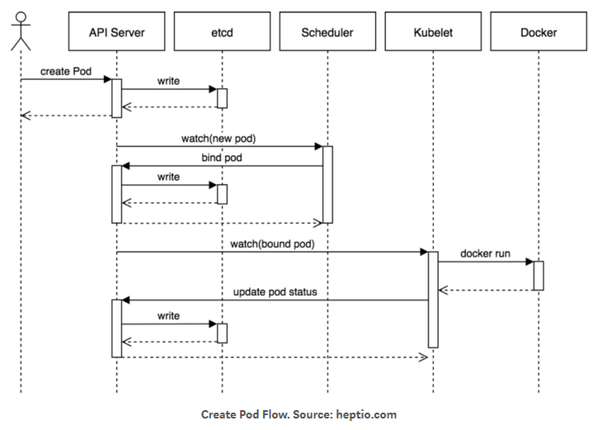
Pod Creation Flow
kubectl writes to the API Server.
API Server validates the request and persists it to etcd.
etcd notifies back the API Server.
API Server invokes the Scheduler.
Scheduler decides where to run the pod on and return that to the API Server.
API Server persists it to etcd.
etcd notifies back the API Server.
API Server invokes the Kubelet in the corresponding node.
Kubelet talks to the Docker daemon using the API over the Docker socket to create the container.
Kubelet updates the pod status to the API Server.
API Server persists the new state in etcd.

Slide 12
Demo

Slide 13
Understanding RBAC
Subjects
Users
Groups
Service Accounts
…
Resources
Deployments
Replicasets
Jobs
StatefulSets
Pods
Daemonsets
PV
…
Verbs
Get
Set
Watch
List
Create
Patch
Delete
…
Subjects: Users, Groups, ServiceAccounts, all of which can access kubernetes API
Resources: API objects that can be created on the cluster
Verbs: Actions possible on the API objects
Notes:
apiVersion: rbac.authorization.k8s.io/v1
kind: RoleBinding
metadata:
name: ibm-privileged-clusterrole-rolebinding
namespace: demo-dep
roleRef:
apiGroup: rbac.authorization.k8s.io
kind: ClusterRole
name: ibm-privileged-clusterrole
subjects:
- apiGroup: rbac.authorization.k8s.io
kind: Group
name: system:serviceaccounts:demo-dep

Slide 14
Roles & RoleBinding
Roles
Subjects
Users
Groups
Service Accounts
…
Resources
Deployments
Replicasets
Jobs
StatefulSets
Pods
Daemonsets
PV
…
Verbs
Get
Set
Watch
List
Create
Patch
Delete
…
RoleBindings assign roles to users/groups/sa

Slide 15
Pod Security Policy
Used to enforce container image security for the pods in your cluster.
Controls the security sensitive aspects of pod specification and the set of conditions that must be met for a pod to be admitted into the cluster.
Notes:
apiVersion: rbac.authorization.k8s.io/v1
kind: RoleBinding
metadata:
name: ibm-privileged-clusterrole-rolebinding
namespace: demo-dep
roleRef:
apiGroup: rbac.authorization.k8s.io
kind: ClusterRole
name: ibm-privileged-clusterrole
subjects:
- apiGroup: rbac.authorization.k8s.io
kind: Group
name: system:serviceaccounts:demo-dep

Slide 16
Fix PSP Issue
New PSP with the required conditions
Role/Clusterrole that allows use of PSP
RoleBinding/ClusterRoleBinding to bind clusterrole to service account in the namespace
apiVersion: rbac.authorization.k8s.io/v1
kind: ClusterRole
metadata:
name: ibm-privileged-clusterrole
rules:
- apiGroups:
- extensions
resourceNames:
- ibm-privileged-psp
resources:
- podsecuritypolicies
verbs:
- use
apiVersion: rbac.authorization.k8s.io/v1
kind: RoleBinding
metadata:
name: ibm-privileged-clusterrole-rolebinding
namespace: demo-dep
roleRef:
apiGroup: rbac.authorization.k8s.io
kind: ClusterRole
name: ibm-privileged-clusterrole
subjects:
- apiGroup: rbac.authorization.k8s.io
kind: Group
name: system:serviceaccounts:demo-dep
Notes:
apiVersion: rbac.authorization.k8s.io/v1
kind: RoleBinding
metadata:
name: ibm-privileged-clusterrole-rolebinding
namespace: demo-dep
roleRef:
apiGroup: rbac.authorization.k8s.io
kind: ClusterRole
name: ibm-privileged-clusterrole
subjects:
- apiGroup: rbac.authorization.k8s.io
kind: Group
name: system:serviceaccounts:demo-dep

Slide 17
Scheduling Issues
Pods in pending state: Node Affinity/Anti Affinity, Taints & Tolerations
Resource Constraints
X
Worker node – 1
Label: kubernetes.io/node-function=web
Worker node – 2
Label: kubernetes.io/node-function=web
Worker node – 3
Label: kubernetes.io/node-function=web
Worker node – 4
Label: kubernetes.io/node-function=web
Worker node – 5

Slide 18
Crashloopbackoff
Pod staring, crashing in a loop
Pod Restart Policy: Always/Never/OnFailure, Default: Always
Failed containers are restarted by the kubelet with an exponential back-off delay (10s, 20s, 40s …) capped at five minutes
Crashloopbackoff typically indicate, application inside the container is crashing
Use kubectl logs to look at the applications logs
Alerts based on pod restart count

Slide 19
Network Issues
CNI Problems: calicoctl, …
Network policies blocking traffic?
Firewalls preventing packets between hosts?
Iptables, conntrack, …
Skydive

Slide 20
Post Deployment
Application validation tests: make sure your successful deployment was a correct deployment
Ongoing monitoring: but avoid "alert fatigue" by choosing your alert conditions well
Adopt a event management with runbooks and rpa to address common issues
Make sure your conditions make sense for your environment
Adopt the chaos monkey tools (powerfulseal, kube-monkey, …)

Slide 21
Thank you.
Arun Balasubramanyan
Lead Solution Architect, System Integrators Lab
abalasu1@in.ibm.com
linkedin: in/arun-balasubramanyan-43098818
twitter: @arunimi

Slide 22




Stay Connected and continue coding !
Code & instructions available here https://github.com/IBMDevConnect
Join our Meetup groups
Mumbai : https://www.meetup.com/Cloud-Mumbai-Meetup/
Hyderabad: https://www.meetup.com/Hyderabad-Cognitive-with-Cloud
Bangalore : https://www.meetup.com/IBMDevConnect-Bangalore
Chennai:
https://www.meetup.com/Chennai-CodeWeekend-Meetup/
Check out the cool developer journeys
https://developer.ibm.com/patterns/
Join our Slack team and stay in touch with the experts
https://ibmdevconnect.slack.com
Send in your request to - http://ibm.biz/slackrequest

